Slide 1

CPQ – Asia Alignment Design and Mock Up Nov ‘19
Colt confidential

Slide 2

Document Release and Change Log Details
CPQ Asia
Version Number | 0.3
Date | 26th Nov, 2019
Change log | Discounting and deal governance SE Engagement scenarios Slide updates after internal review

Slide 3
CPQ Asia : Discounting and Deal Governance
Email notifications to commercial operations team Asia based on the Colt Org Country (JP,HK,SG,SK)-
Separate views for commercial operations team Asia and deal pricing team Europe in Transaction manager in CPQ

Slide 4
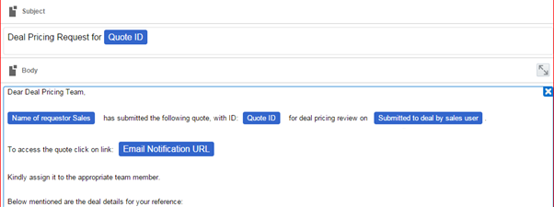
CPQ Asia : Email notifications
Sample Notification to deal pricing team
Deal pricing email notifications to be triggered to appropriate team based on the Colt Org Countries
Deal pricing email notification for Asia will go to ‘GS-Pricing@colt.net’

Slide 5
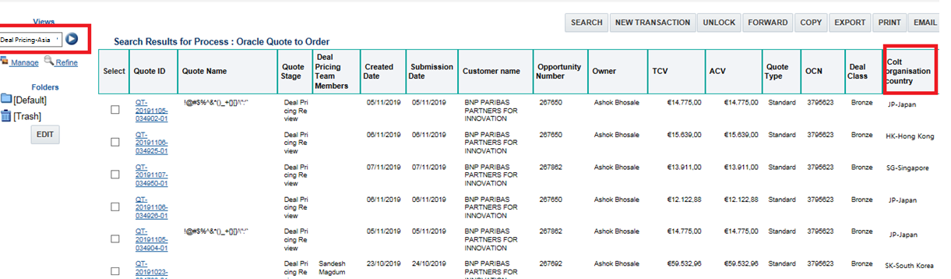
CPQ Asia : Transaction Manager View
All deal pricing requests for the quotes where colt org country is Asia (JP,HK,SG,SK) will be sent to commercial operations team
A separate transaction manager view will be created for commercial operations team based on the Colt Org country
Name of the View will ‘Deal Pricing Asia’. The existing deal pricing view would be renamed to ‘Deal Pricing EU’. Column required for ‘Deal Pricing Asia’ would exactly the same as the existing Deal Pricing Asia view.
All deal pricing users will have access to both Asia and EU views

Slide 6
CPQ Asia : MMT Changes
Areas where MMT changes are required for Asia requirements. All the below requirements are product agnostic .
BMO Charges for Hong Kong
One time Opex – CPQ/MMT currently supports recurring Opex
MMT Export Impact only:
Supplier Surcharge for Hong Kong – A flag to indicate that the base prices are elevated
If the Access Type = ULL Fibre , then CPQ should translate it to Colt Fibre in the Pricing export. While importing back the sheet from MMT into CPQ the Access Type column does not come back in the import sheet , hence no change .
Colt Fibre – Additional Charge Opex and Capex might get added. These will be mapped to base bespoke cost

Slide 7
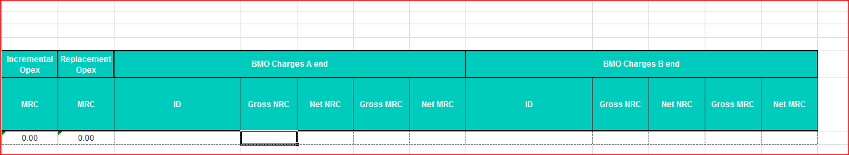
CPQ Asia : MMT Changes-BMO
BMO charges
New columns for BMO charges will be added in the pricing export templates for Ethernet Line, H&S, wave and IP Access
Charges will be at site-level.
No additional logic to be written in MMT to make these fields Asia specific
MMT should able to consume the BMO charges
Import from MMT into CPQ should have BMO charges
Deal pricing team should not discount the BMO charges (Process)

Slide 8
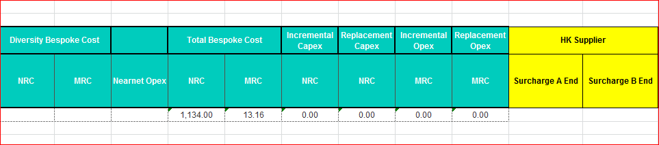
CPQ Asia : MMT Changes: Supplier Surcharge for Hong Kong
Supplier Surcharge
In case system applies supplier surcharge for Hong Kong sites then a flag should be send to MMT
This flag will indicate to the Deal pricing team the reason for elevated base charge
The name of the flag should be ‘HK Supplier Surcharge’
Charges will be at site-level.
MMT export sheet should be enhanced to accommodate this flag
MMT will not consume this flag
While importing back the sheet from MMT into CPQ this Flag will not come back in the import sheet ,
hence no change .

Slide 9
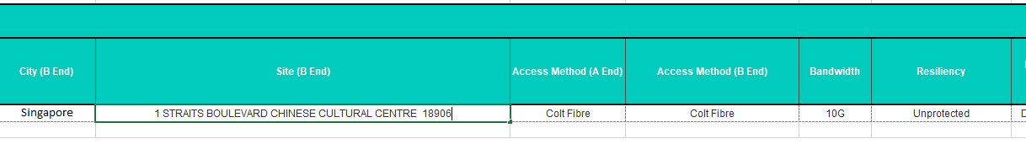
CPQ Asia: MMT: Access Type = ULL Fibre
Update city
If the Access Type = ULL Fibre, then CPQ should translate the access type to Colt Fibre in the MMT export.
This change is required for Ethernet Line, Ethernet Hub, Ethernet Spoke, Wave & IPAccess
While importing back the sheet from MMT into CPQ the Access Type column does not come back in the
import sheet , hence no change .

Slide 10
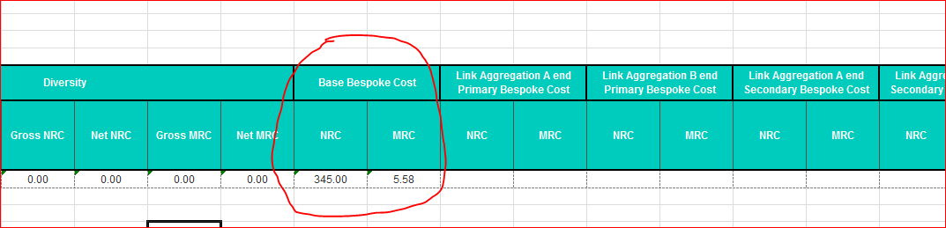
CPQ Asia : MMT Changes-Colt Fibre
Colt Fibre non-standard configuration
No new columns required in pricing export sheets for all products
Existing CAPEX,OPEX will be added in the Base price bespoke cost columns similar to non-standard interfaces

Slide 11
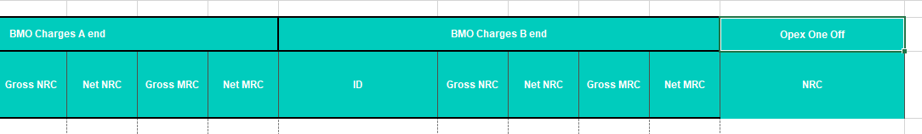
CPQ Asia : MMT Changes: One Time Opex
One Time Opex:
One time Opex should be available in CPQ for Bespoke and SE engagement journeys across all the applicable scenario
In the pricing export CPQ should do a summation of all the One time Opex present in the quote and populate the ‘One Time Opex’ field on pricing export

Slide 12
CPQ Asia: Governance Hierarchy post Deal Pricing Review
No Change
Once the Quote has been approved by deal pricing, the Governance Approval Hierarchy is determined by the profitability of the Deal (IGMAD %) & connectivity type of the Line model.
Sales and Finance Approval hierarchy for Asia will be aligned with EU
Data(On-net)
Data(Off-net/NearNet)
If all lines contain only on-net connections, the following thresholds apply:
If any line contains off-net or near-net connection, the following thresholds should apply instead:
Deal Class | Profitability (IGMAD) | Sales approver | Finance approver
Bronze+ or Silver | >= 30% | VP Sales – 2 | VP Finance – 2
 | < 30% and >= 25% | VP Sales – 1 | VP Finance – 1
 | < 25% | VP Sales | VP Finance
Gold | Any value | CRO | VP Finance
Platinum | Any value | CRO | VP Finance CFO
Deal Class | Profitability (IGMAD) | Sales approver | Finance approver
Bronze+ or Silver | >= 20% | VP Sales – 2 | VP Finance – 2
 | < 20% and >= 17% | VP Sales – 1 | VP Finance – 1
 | < 17% | VP Sales | VP Finance
Gold | Any value | CRO | VP Finance
Platinum | Any value | CRO | VP Finance CFO
Exception: If the quote is raised by a US Sales User, then the approvals are always routed to the “US Finance Approver” user (“Herve Jost”) and do not follow the above hierarchy

Slide 13
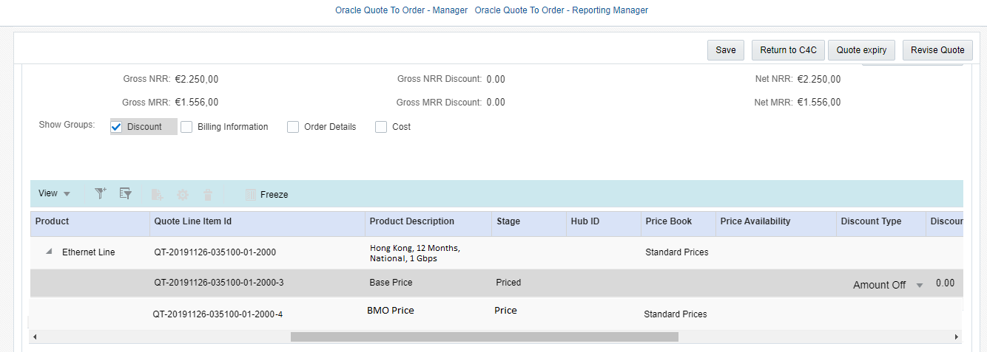
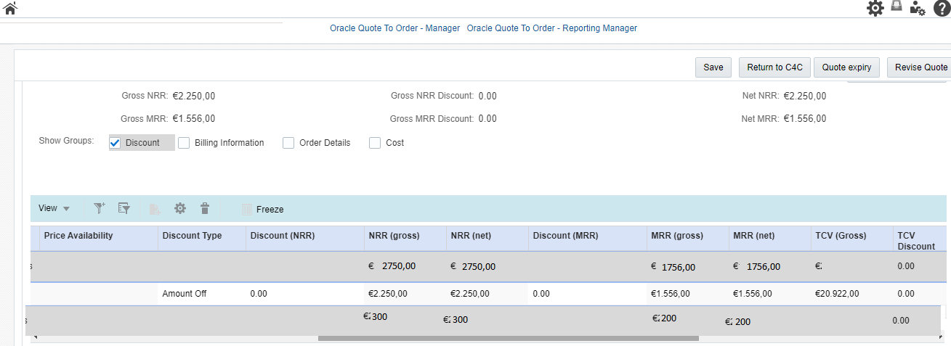
CPQ Asia: BMO Discounting
Update
Sales user should not be able to discount the BMO charges
The discounting option would be disabled during the discounting journey
The net and gross values should be shown same to user for BMO charges

Slide 14
CPQ Asia : SE Engagement scenarios for Asia
Product Specific / Generic | SE Journey / Bespoke | Scenario | Region (EU/US, Asia, All) | Mandatory in Config / On Need Basis
Wave | SE Journey | Manual near-net is needed | EU/US, Asia (SGP) | Mandatory in Configuration
 |  | Dual Entry is needed (ULL Fibre, 3rd party leased line) | All | Mandatory in Configuration
 |  | Manual Off-net (ULL Fibre, 3rd party leased line) is needed | All | Mandatory in Configuration
 |  | Customer Defined Route is required | All | Mandatory in Configuration
 |  | Service Type requested by Customer is not available at the site for DC & RB | All | Mandatory in Configuration
 |  | Diversity feature is required | All | Mandatory in Configuration
 |  | Protected Resilience is required | Asia | On Need Basis
IP Access | SE Journey | If the Diversity is requested by the customer the Sales User must engage an SE | All | Mandatory in Configuration
 |  | When Customer Requires a “Specific Managed COLT Router” or “Specific Unmanaged COLT Router” _ This is not a mandatory SE engagement. Sales only engages SE, if support is required to fill the required information which are: a. Contractually Agreed Router? b. Router LAN Interface Type c. COLT CPE ID d. CPE Cost Currency e. Cost of CPE f. Router Model | All | On Need Basis
 |  | When the Manual Engagement response for a Non Colt Country back from ONQT team has access type = “3rd Party Leased Line”. | All | Mandatory in Configuration
All Products (Ethernet, Wave, IP Access) | SE Journey | For Japan, when Access type = 'Colt Fibre' | Asia (JP) | Mandatory in Configuration
All Products (Ethernet, Wave, IP Access) | SE Journey | For Japan, when NTT data coverage result is NG (Not Good) | Asia (JP) | Mandatory in Configuration
All Products (Ethernet, Wave, IP Access) | Bespoke | Any scenario not covered by standard or SE journey | All | Mandatory in Configuration
Product Specific / Generic | SE Journey / Bespoke | Scenario | Region (EU/US, Asia, All) | Mandatory in Config / On Need Basis

Slide 15
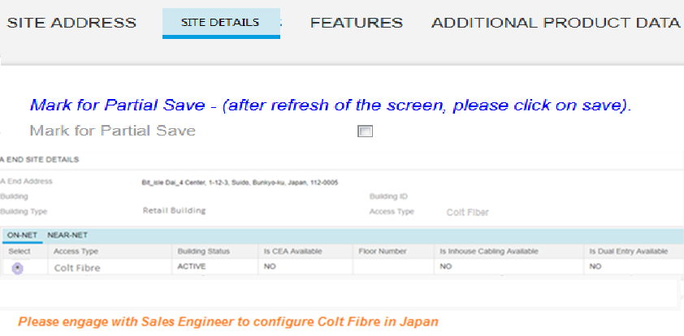
CPQ Asia : Colt Fibre Configuration in Japan
Sales User
Whenever sales user selects the Colt Fibre response for Japan, he will see a message on the screen “Please engage with Sales Engineer for Colt Fibre in Japan”
Sales user will then partially save and engage SE to complete Colt Fiber configuration in Japan.
Quote line-item stage will remain “Created”
Existing EU process for Sales to engage SE will be used in Asia too.

Slide 16
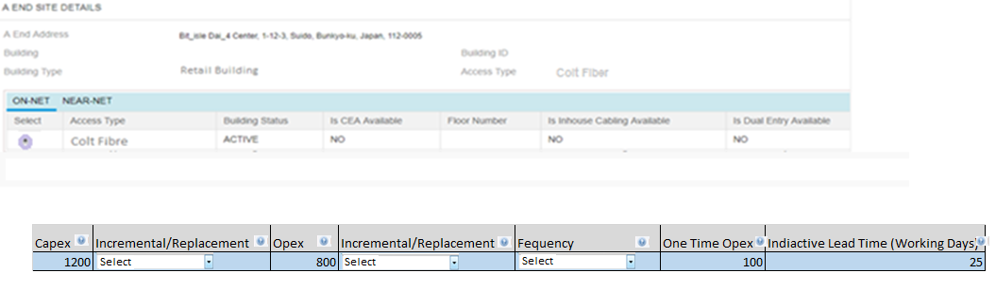
CPQ Asia : Colt Fibre Configuration in Japan
Sales Engineer
Colt Fibre Additional Charges
SE will see a section for Colt Fibre Additional Charges . This section has Capex , Opex , One time opex and indicative lead time fields presented to the SE
Introduction of one time opex has to be done across all the SE journeys. It should not have Incremental/ Replacement and Frequency columns
SE works with Network planning team offline to get the info- cost, capacity check, indicative lead time.
SE will work closely will sales in case the Colt Fibre option is not available for the request raised. The alternatives will discussed and accordingly SE can configure the ULL Fibre option
If additional cost is entered by SE, the line-item will change to “Additional cost required” stage and will be sent to deal pricing
If there is no additional cost added by SE and there are no other line-items requiring deal pricing approval, quote can be self approved by Sales.
When quote is saved and sent back to Sales, fields are visible to Sales users in line-item grid but as read only.

Slide 17
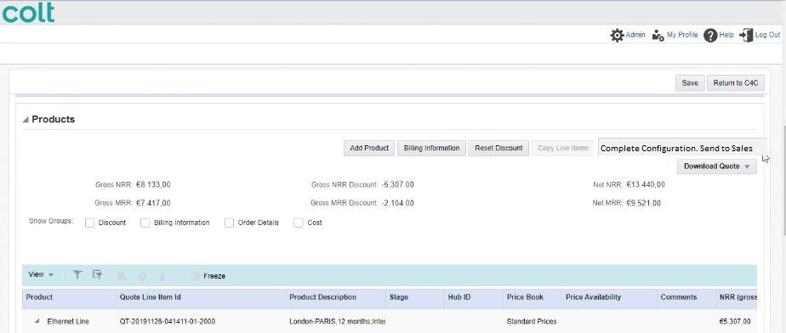
CPQ Asia : Colt Fibre Configuration in Japan
Sales Engineer
Once SE complete the configuration, he will have to click on the ‘Complete Configuration. Send to Sales’ button. This will send the Opex and Capex details to sales

Slide 18
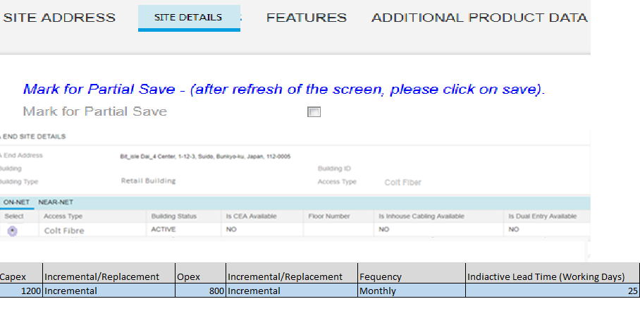
CPQ Asia : Colt Fibre Configuration in Japan
Sales
Once SE send back the quote to Sales then Sales will see the see the Capex and Opex vales entered by SE in the read only mode
Colt Fibre Additional Charges

Slide 19
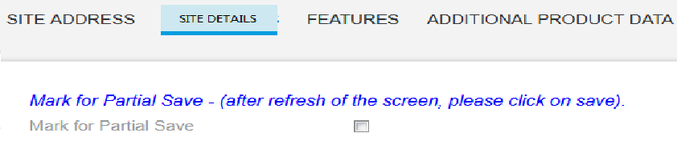
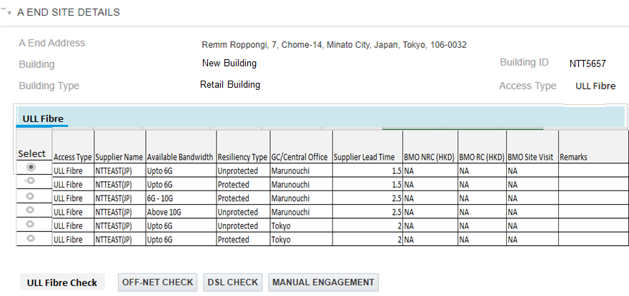
CPQ Asia : ULL Connectivity in Japan
Sales
In case the selected ULL Fiber record is marked as ‘NG’ in the NTT Dataset then CPQ will provide a message to the user that ‘Please engage SE as the selected site is indicated as a Not Good (NG) by the supplier’
Sales user will then partially save and engage SE to complete ULL Fiber configuration in Japan.
Quote line-item stage will remain “Created”
Please engage SE as the selected site is indicated as a Not Good (NG) by the supplier

Slide 20
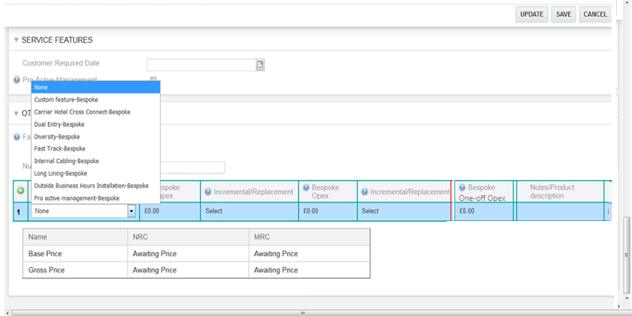
CPQ Asia : ULL Connectivity in Japan
Sales Engineer
SE will use the bespoke section to select the ‘Custom Feature-Bespoke’ drop value from the Bespoke Feature Column

Slide 21
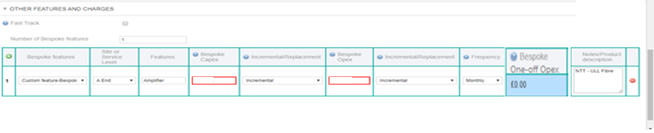
CPQ Asia : ULL Connectivity in Japan
Sales Engineer
SE can enter the component requirement in the Feature column. Feature Column is free text.
SE can enter the Opex and capex (for Asia SE can indicate a dummy value to trigger Commercial Operation for Price calculation)
This will trigger the deal pricing workflow where ‘Commercial Operations’ will get the appropriate charges for the ULL Fibre ‘NG’ scenarios.

Slide 22
CPQ Asia: Bespoke : One time Opex
One time opex field to be added in the bespoke journey
Please note: Introduction of one time opex has to be done across all the SE journeys. It should not have Incremental/ Replacement and Frequency columns

Slide 23
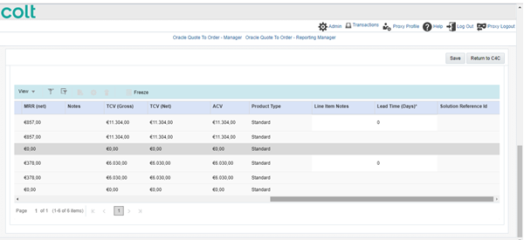
CPQ Asia: Bespoke : Rule update
The Solution Id reference field for the bespoke journey will be made optional across all product
Solution design document should be optional
Remove the validation that bespoke journey is only applicable if the technical complexity is 2 or above. System should allow the user to progress the bespoke journey even when the technical complexity is 1
The above rules should be implemented across all product and geographies

